Slide 1
PROGRAM STUDI INFORMATIKA
FAKULTAS TEKNIK DAN INFORMATIKA
UNIVERSITAS MULTIMEDIA NUSANTARA
SEMESTER GASAL TAHUN AJARAN 2024/2025
IF542– Deep Learning
Minggu/Pertemuan ke 3 – Deep Learning
Dosen Penyusun :
David Agustriawan, Ph.D.

Slide 2
OUTLINE
Why Deep Learning
Multi Layer perceptron
Intro. To Convolutional Neural Network

Slide 3


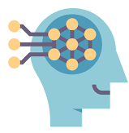
What is Deep Learning?
ARTIFICIAL INTELIGENCE
MACHINE LEARNING
DEEP LEARNING
Extract patterns from data using neural networks
Any technique that enables computers to mimic human behavior
Ability to learn without explicitly being programmed
Notes:
Source : Alexander Amini MIT http://introtodeeplearning.com/slides/6S191_MIT_DeepLearning_L1.pdf

Slide 4
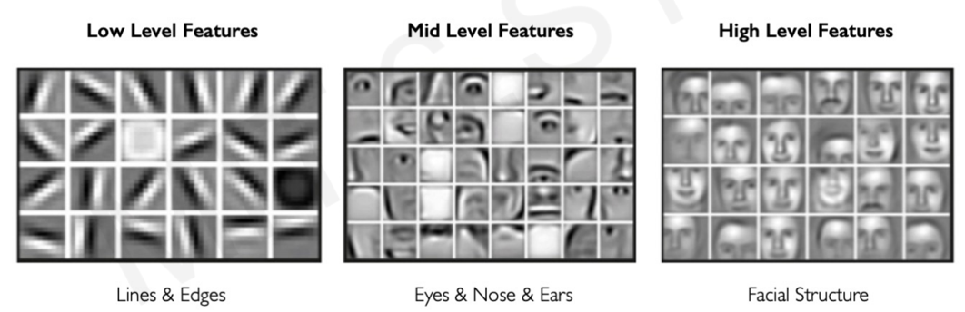
Why Deep Learning?
Hand engineered features are time consuming, brittle, and not scalable in practice.
Can we learn the underlying features directly from data??
Source : Amini A, MIT 2021

Slide 5
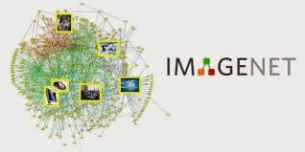
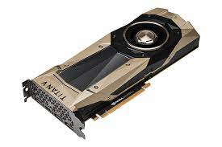


Why Now?
Neural networks date back decades, so why the resurgence??
1952
Stochastic Gradient Desecnt
BIG DATA
HARDWARE
SOFTWARE
1958
Perceptron (Learnable Weights)
Graphics Processing Units (GPUs)
Massively parallelizable
Improved techniques
New models
Toolboxes
Larger datasets
Easier collection & storage
1986
Backproagation (MLP)
1995
Deep Convolutional NN (digit recog)

Slide 6
What is the Challenge – Motivation
To many concept to learn
  Too many object categories
  Too many ways of interaction between object categories
Behavior is a highly varying function underlying factor
  If f: L→ V
  L : latent factors of variation
    Low dimensional latent factor space
  V : visible behavior
    Highly dimensional observable spaces
  f : highly non linear function

Slide 7
So, How do We Train Deep Architectures?
Inspiration from mammal brain
Multiple layers of “neurons”
Train each layer to compose the representation of the previous layer to learn a higher level abstraction
  Ex : Pixels → edges → contours → object part → object categories
  Local features V Global features
Train the layes one-by-one (see : Hinton et al, 2006)
  Greedy Strategy
Notes:
Hinton, G. E., Osindero, S. and Teh, Y. A fast learning algorithm for deep belief nets. Neural Computation 18 (2006), pp 1527-1554

Slide 8
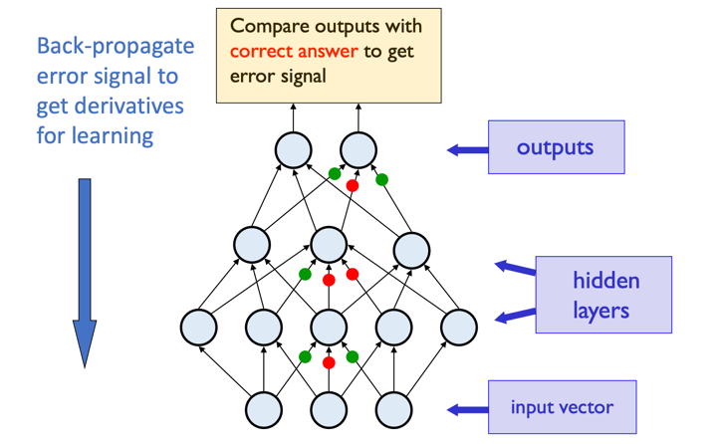
Multi Layer Perceptron with BackPropagation
First deep learning model
Source : Hinton 2009, Tutorial on Deep belief Network – Univ of Toronto
Notes:
Sumber Video Lectures : http://videolectures.net/mlss09uk_hinton_dbn/

Slide 9
Drawbacks of BackPropagation based Deep neural Networks
They are discriminative models
  Get all the information from the labels
    And the labels dont give so much of information
  Need a substantial amount of labeled data
Gradient descent with random initialization leads to poor local minima

Slide 10
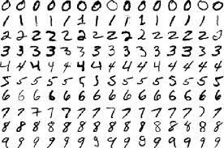
Let’s See More Deeper..
Hand written digit recognition
Let we use classic example hand written dataset : MNIST (LeCun et al,1998)
10 digit classes
Input image : 28 x 28 grayscale
  784 dimensional input
Notes:
Sumber : http://yann.lecun.com/exdb/mnist/

Slide 11
Let’s See More Deeper..
Hand written digit recognition – cont’
One hidden layer with 500 neurons
Fitting a model that best explains the training data is an optimization problem in a 0.4 million dimensional space
==> 784 * 500 + 500 * 10
≈ 0.4 million weights
Its almost impossible for Gradient Descent with random initialization to arrive at the global optimum
SOLUTION? Lets used Deep Learning..
Deep Learning – Covolutional Neural Network

Slide 12
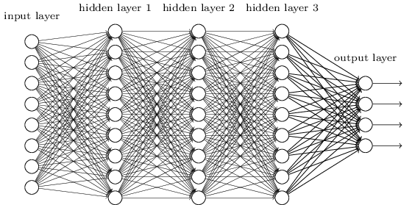
Smaller Network: CNN
We know it is good to learn a small model.
From this fully connected model, do we really need all the edges?
Can some of these be shared?

Slide 13
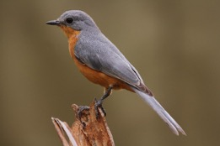
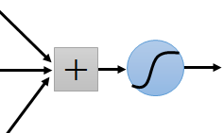
Consider learning an image:
Some patterns are much smaller than the whole image
Can represent a small region with fewer parameters
“beak” detector

Slide 14
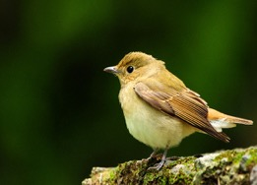
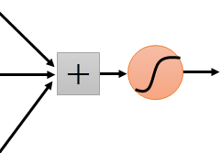
Same pattern appears in different places:
They can be compressed!
What about training a lot of such “small” detectors and each detector must “move around”.
Consider learning an image:
“upper-left beak” detector
They can be compressed
to the same parameters.
“middle beak” detector

Slide 15
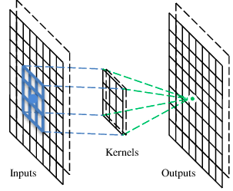
A convolutional layer
A CNN is a neural network with some convolutional layers
(and some other layers). A convolutional layer has a number
of filters that does convolutional operation.
Beak detector
A filter

Slide 16
Convolution
These are the network parameters to be learned.
1 | -1 | -1
-1 | 1 | -1
-1 | -1 | 1
1 | 0 | 0 | 0 | 0 | 1
0 | 1 | 0 | 0 | 1 | 0
0 | 0 | 1 | 1 | 0 | 0
1 | 0 | 0 | 0 | 1 | 0
0 | 1 | 0 | 0 | 1 | 0
0 | 0 | 1 | 0 | 1 | 0
Filter 1
-1 | 1 | -1
-1 | 1 | -1
-1 | 1 | -1
Filter 2
……
6 x 6 image
Each filter detects a small pattern (3 x 3).
Notes:
Diadaptasi dari sumber : Suyanto. 2018. Machine Learning tingkat dasar dan lanjut. Penerbit Informatika

Slide 17
Convolution
1 | -1 | -1
-1 | 1 | -1
-1 | -1 | 1
Filter 1
stride=1
1 | 0 | 0 | 0 | 0 | 1
0 | 1 | 0 | 0 | 1 | 0
0 | 0 | 1 | 1 | 0 | 0
1 | 0 | 0 | 0 | 1 | 0
0 | 1 | 0 | 0 | 1 | 0
0 | 0 | 1 | 0 | 1 | 0
Dot
product
3
-1
6 x 6 image

Slide 18
Convolution
1 | -1 | -1
-1 | 1 | -1
-1 | -1 | 1
Filter 1
If stride=2
1 | 0 | 0 | 0 | 0 | 1
0 | 1 | 0 | 0 | 1 | 0
0 | 0 | 1 | 1 | 0 | 0
1 | 0 | 0 | 0 | 1 | 0
0 | 1 | 0 | 0 | 1 | 0
0 | 0 | 1 | 0 | 1 | 0
3
-3
6 x 6 image

Slide 19
Convolution
1 | -1 | -1
-1 | 1 | -1
-1 | -1 | 1
Filter 1
stride=1
1 | 0 | 0 | 0 | 0 | 1
0 | 1 | 0 | 0 | 1 | 0
0 | 0 | 1 | 1 | 0 | 0
1 | 0 | 0 | 0 | 1 | 0
0 | 1 | 0 | 0 | 1 | 0
0 | 0 | 1 | 0 | 1 | 0
3
-1
-3
-1
-3
1
0
-3
-3
-3
0
1
3
-2
-2
-1
6 x 6 image

Slide 20
Convolution
-1 | 1 | -1
-1 | 1 | -1
-1 | 1 | -1
Filter 2
stride=1
Repeat this for each filter
1 | 0 | 0 | 0 | 0 | 1
0 | 1 | 0 | 0 | 1 | 0
0 | 0 | 1 | 1 | 0 | 0
1 | 0 | 0 | 0 | 1 | 0
0 | 1 | 0 | 0 | 1 | 0
0 | 0 | 1 | 0 | 1 | 0
3
-1
-3
-1
-1
-1
-1
-1
-3
1
0
-3
-1
-1
-2
1
Feature
Map
-3
-3
0
1
-1
-1
-2
1
3
-2
-2
-1
6 x 6 image
-1
0
-4
3
Two 4 x 4 images
Forming 2 x 4 x 4 matrix

Slide 21
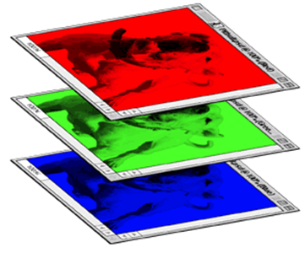
Color image: RGB 3 channels
1 | -1 | -1
-1 | 1 | -1
-1 | -1 | 1
-1 | 1 | -1
-1 | 1 | -1
-1 | 1 | -1
1 | -1 | -1
-1 | 1 | -1
-1 | -1 | 1
-1 | 1 | -1
-1 | 1 | -1
-1 | 1 | -1
1 | -1 | -1
-1 | 1 | -1
-1 | -1 | 1
-1 | 1 | -1
-1 | 1 | -1
-1 | 1 | -1
Filter 1
Filter 2
Color image
1 | 0 | 0 | 0 | 0 | 1
0 | 1 | 0 | 0 | 1 | 0
0 | 0 | 1 | 1 | 0 | 0
1 | 0 | 0 | 0 | 1 | 0
0 | 1 | 0 | 0 | 1 | 0
0 | 0 | 1 | 0 | 1 | 0
1 | 0 | 0 | 0 | 0 | 1
0 | 1 | 0 | 0 | 1 | 0
0 | 0 | 1 | 1 | 0 | 0
1 | 0 | 0 | 0 | 1 | 0
0 | 1 | 0 | 0 | 1 | 0
0 | 0 | 1 | 0 | 1 | 0
1 | 0 | 0 | 0 | 0 | 1
0 | 1 | 0 | 0 | 1 | 0
0 | 0 | 1 | 1 | 0 | 0
1 | 0 | 0 | 0 | 1 | 0
0 | 1 | 0 | 0 | 1 | 0
0 | 0 | 1 | 0 | 1 | 0

Slide 22
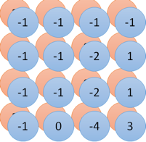
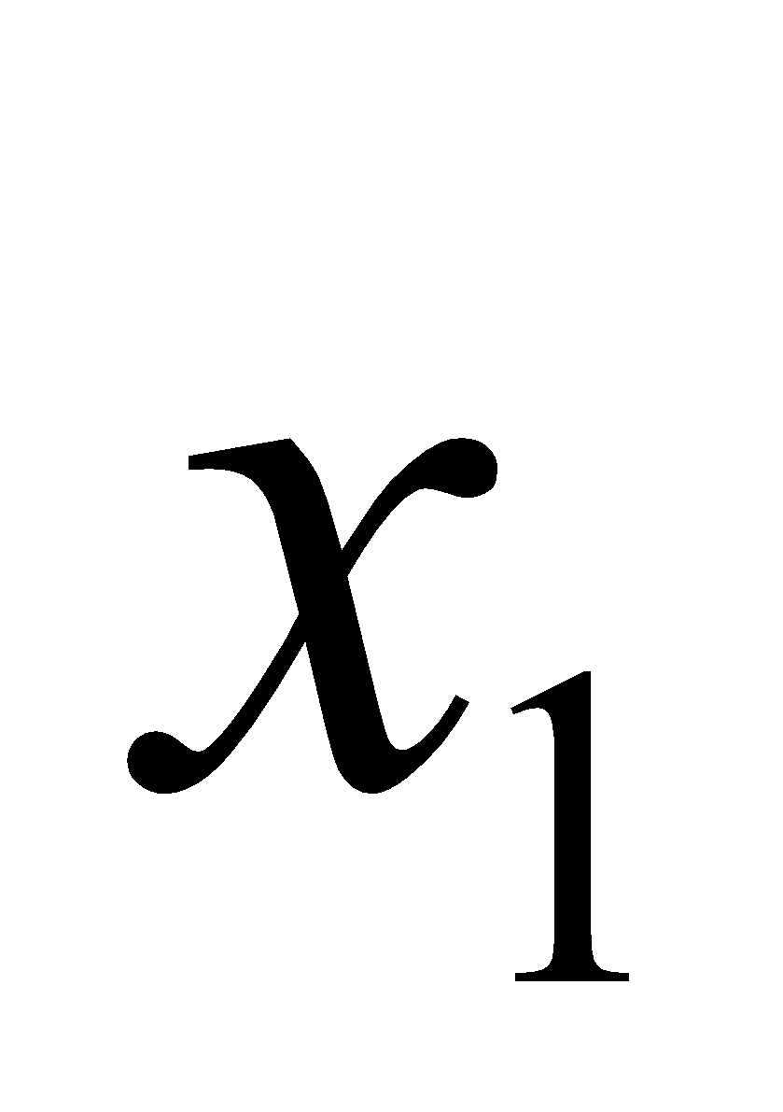
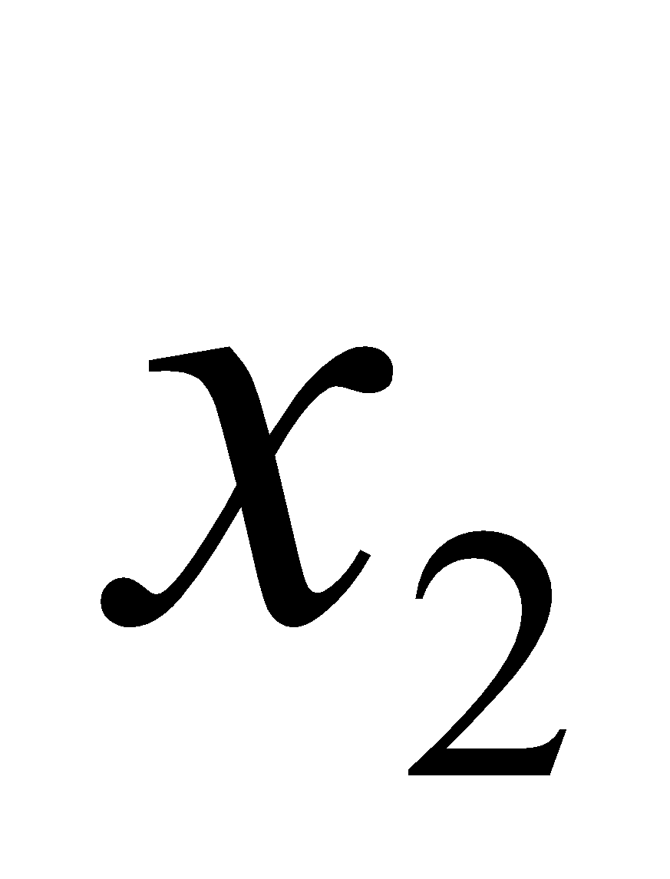
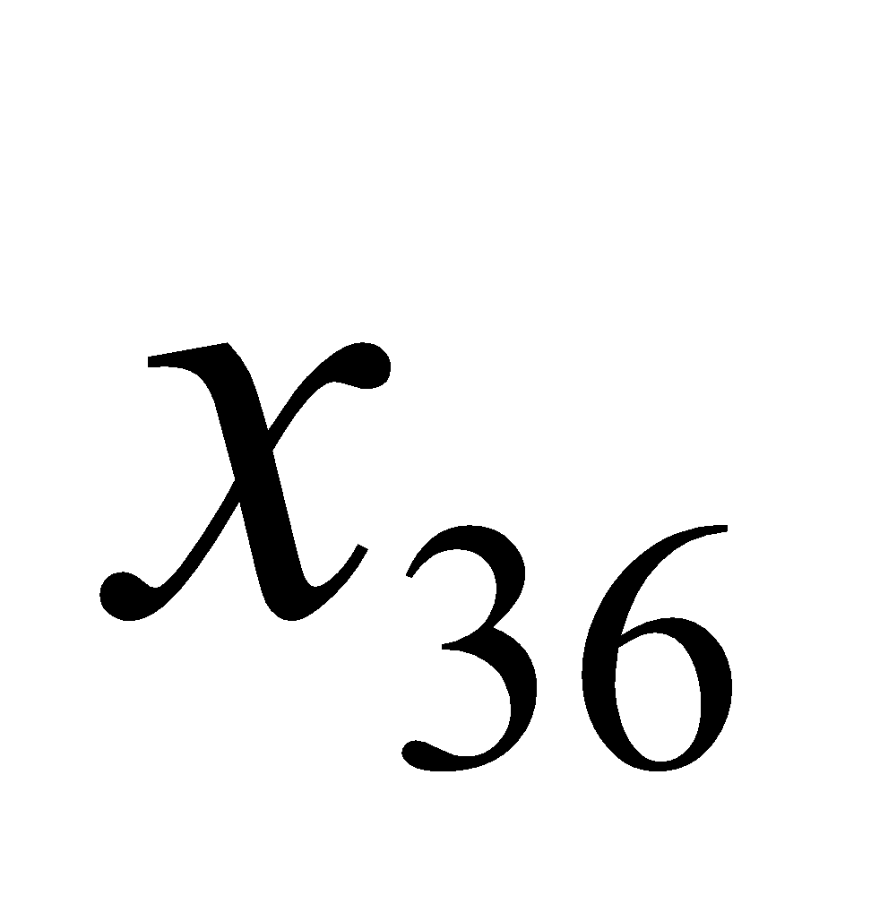
Convolution v.s. Fully Connected
1 | 0 | 0 | 0 | 0 | 1
0 | 1 | 0 | 0 | 1 | 0
0 | 0 | 1 | 1 | 0 | 0
1 | 0 | 0 | 0 | 1 | 0
0 | 1 | 0 | 0 | 1 | 0
0 | 0 | 1 | 0 | 1 | 0
1 | -1 | -1
-1 | 1 | -1
-1 | -1 | 1
-1 | 1 | -1
-1 | 1 | -1
-1 | 1 | -1
convolution
image
1 | 0 | 0 | 0 | 0 | 1
0 | 1 | 0 | 0 | 1 | 0
0 | 0 | 1 | 1 | 0 | 0
1 | 0 | 0 | 0 | 1 | 0
0 | 1 | 0 | 0 | 1 | 0
0 | 0 | 1 | 0 | 1 | 0
Fully-connected
……
……

Slide 23
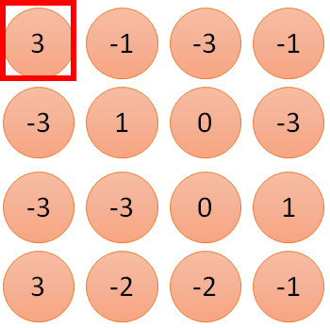
1 | -1 | -1
-1 | 1 | -1
-1 | -1 | 1
1
1
Filter 1
2
0
3
0
3
4:
0
1 | 0 | 0 | 0 | 0 | 1
0 | 1 | 0 | 0 | 1 | 0
0 | 0 | 1 | 1 | 0 | 0
1 | 0 | 0 | 0 | 1 | 0
0 | 1 | 0 | 0 | 1 | 0
0 | 0 | 1 | 0 | 1 | 0
…
0
8
1
9
0
10:
0
…
13
0
6 x 6 image
14
0
fewer parameters!
15
Only connect to 9 inputs, not fully connected
1
16
1
…

Slide 24
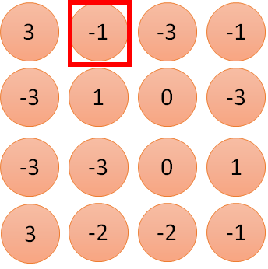
1 | -1 | -1
-1 | 1 | -1
-1 | -1 | 1
1:
1
Filter 1
2:
0
3:
0
3
4:
0
1 | 0 | 0 | 0 | 0 | 1
0 | 1 | 0 | 0 | 1 | 0
0 | 0 | 1 | 1 | 0 | 0
1 | 0 | 0 | 0 | 1 | 0
0 | 1 | 0 | 0 | 1 | 0
0 | 0 | 1 | 0 | 1 | 0
…
7:
0
8:
1
-1
9:
0
10:
0
…
13:
0
6 x 6 image
14:
0
Fewer parameters
15:
1
16:
1
Shared weights
Even fewer parameters
…

Slide 25
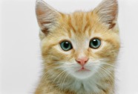
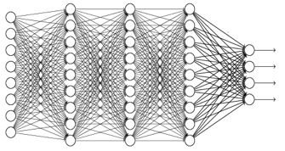
The whole CNN
cat dog ……
Convolution
Max Pooling
Can repeat many times
Fully Connected Feedforward network
Convolution
Max Pooling
Flattened

Slide 26
Max Pooling
1 | -1 | -1
-1 | 1 | -1
-1 | -1 | 1
-1 | 1 | -1
-1 | 1 | -1
-1 | 1 | -1
Filter 1
Filter 2
3
-1
-3
-1
-1
-1
-1
-1
-3
1
0
-3
-1
-1
-2
1
-3
-3
0
1
-1
-1
-2
1
3
-2
-2
-1
-1
0
-4
3

Slide 27
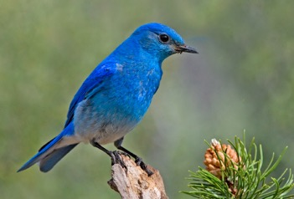
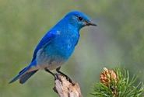
Why Pooling
Subsampling pixels will not change the object
bird
bird
Subsampling
We can subsample the pixels to make image smaller
fewer parameters to characterize the image

Slide 28
A CNN compresses a fully connected network in two ways:
Reducing number of connections
Shared weights on the edges
Max pooling further reduces the complexity

Slide 29
Max Pooling
New image
but smaller
1 | 0 | 0 | 0 | 0 | 1
0 | 1 | 0 | 0 | 1 | 0
0 | 0 | 1 | 1 | 0 | 0
1 | 0 | 0 | 0 | 1 | 0
0 | 1 | 0 | 0 | 1 | 0
0 | 0 | 1 | 0 | 1 | 0
Conv
3
0
-1
1
Max
Pooling
3
1
0
3
2 x 2 image
6 x 6 image
Each filter
is a channel

Slide 30
The whole CNN
3
0
-1
1
Convolution
3
1
0
3
Max Pooling
Can repeat many times
A new image
Convolution
Smaller than the original image
The number of channels is the number of filters
Max Pooling

Slide 31
The whole CNN
cat dog ……
Convolution
Max Pooling
Fully Connected Feedforward network
A new image
Convolution
Max Pooling
Flattened
A new image

Slide 32
Flattening
3
0
1
3
0
-1
1
3
3
1
-1
0
3
Flattened
1
Fully Connected Feedforward network
0
3

Slide 33
Recurrent Neural Network
y
RNN
x
Notes:
Source : Ruohan Zhang (standford university) https://cs231n.stanford.edu/
lecture_10_ruohan.pdf

Slide 34
Recurrent Neural Network
y
Key idea: RNNs have an “internal state” that is updated as a sequence is processed
RNN
x

Slide 35
Unrolled RNN
y₁
y₂
y₃
y_{t}
RNN
RNN
RNN
RNN
...
x₁
x₂
x₃
x_{t}

Slide 36

RNN hidden state update
y
Process a sequence of vectors x by applying a recurrence formula at every time step:
RNN
new state old state input vector at
some time step
x
some function
with parameters W

Slide 37

RNN output generation
y
Process a sequence of vectors x by applying a recurrence formula at every time step:
RNN
output
new state
x
another function with parameters W_{o}

Slide 38
Recurrent Neural Network
y₁
y₂
y₃
y_{t}
h₀
RNN
h₁
RNN
h₂
RNN
h₃
RNN
...
x₁
x₂
x₃
x_{t}

Slide 39
Recurrent Neural Network
y
Process a sequence of vectors x by applying a recurrence formula at every time step:
RNN
x
Notice: the same function and the same set of parameters are used at every time step.
Fei-Fei Li, Jiajun Wu, Ruohan Gao

Slide 40

(Vanilla) Recurrent Neural Network
The state consists of a single “hidden” vector h:
y
RNN
x
Sometimes called a “Vanilla RNN” or an “Elman RNN” after Prof. Jeffrey Elman

Slide 41
RNN: Computational Graph
h₀
h₁
f_{W}
x₁

Slide 42
RNN: Computational Graph
h₀
h₁
h₂
f_{W}
f_{W}
x₁
x₂

Slide 43
RNN: Computational Graph
h₀
h₁
h₂
h₃
…
h_{T}
f_{W}
f_{W}
f_{W}
x₁
x₂
x₃

Slide 44
RNN: Computational Graph
Re-use the same weight matrix at every time-step
h₃
…
h_{T}
h₀
f_{W}
h₁
f_{W}
h₂
f_{W}
x₁
x₂
x₃
W

Slide 45
RNN: Computational Graph: Many to Many
y₁
y₂
y₃
y_{T}
h₃
…
h_{T}
h₀
f_{W}
h₁
f_{W}
h₂
f_{W}
x₁
x₂
x₃
W

Slide 46
RNN: Computational Graph: Many to Many
y₁
y₂
y₃
y_{T}
L₁
L₂
L₃
L_{T}
h₃
…
h_{T}
h₀
f_{W}
h₁
f_{W}
h₂
f_{W}
x₁
x₂
x₃
W
Lecture 10 - 28
April 28, 2022

Slide 47
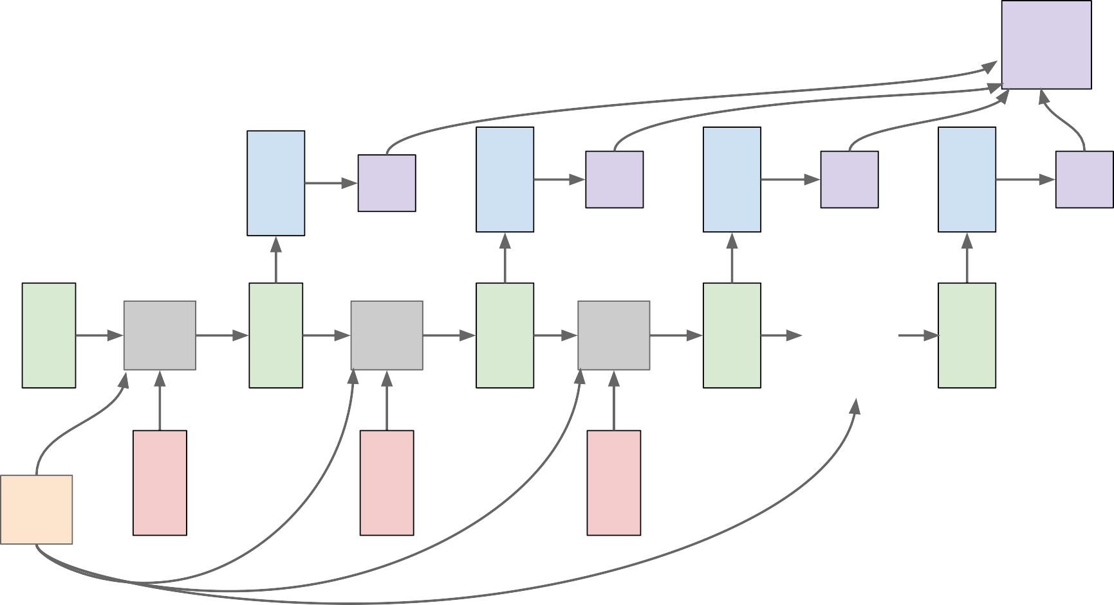
RNN: Computational Graph: Many to Many
L
 | y₁ | L₁ | y₂ | L₂ | y₃ | L₃ | y_{T} | L_{T}
f_{W} x₁ | h₁ | f_{W} x₂ | h₂ | f_{W} x₃ | h₃ | … | h_{T}
h₀
W
Fei-Fei Li, Jiajun Wu, Ruohan Gao

Slide 48
RNN: Computational Graph: Many to One
y
h₃
…
h_{T}
h₀
f_{W}
h₁
f_{W}
h₂
f_{W}
x₁
x₂
x₃
W
Fei-Fei Li, Jiajun Wu, Ruohan Gao

Slide 49
RNN: Computational Graph: Many to One
y
h₃
…
h_{T}
h₀
f_{W}
h₁
f_{W}
h₂
f_{W}
x₁
x₂
x₃
W

Slide 50
RNN: Computational Graph: One to Many
y₁
y₂
y₃
y_{T}
h₃
…
h_{T}
h₀
f_{W}
h₁
f_{W}
h₂
f_{W}
x
W

Slide 51
RNN: Computational Graph: One to Many
y₁
y₂
y₃
y_{T}
h₃
…
h_{T}
h₀
f_{W}
h₁
f_{W}
h₂
f_{W}
x
?
?
?
W

Slide 52
RNN: Computational Graph: One to Many
y₁
y₂
y₃
y_{T}
h₃
…
h_{T}
h₀
f_{W}
h₁
f_{W}
h₂
f_{W}
x
0
0
0
W
April 28, 2022

Slide 53
RNN: Computational Graph: One to Many
y₁
y₂
y₃
y_{T}
h₃
…
h_{T}
h₀
f_{W}
h₁
f_{W}
h₂
f_{W}
x
y₁
y₂
y
W
T-1

Slide 54
Sequence to Sequence: Many-to-one + one-to-many
Many to one: Encode input sequence in a single vector
h₀
h₁
h₂
h₃
…
h_{T}
f_{W}
f_{W}
f_{W}
x₁
x₂
x₃
W₁
Sutskever et al, “Sequence to Sequence Learning with Neural Networks”, NIPS 2014

Slide 55
Sequence to Sequence: Many-to-one + one-to-many
One to many: Produce output sequence from single input vector
Many to one: Encode input
sequence in a single vector
y₁
y₂
h₀
h₁
h₂
h₃
…
h_{T}
h₁
h₂
…
f_{W}
f_{W}
f_{W}
f_{W}
f_{W}
f_{W}
x₁
x₂
x₃
W₁
W₂
Sutskever et al, “Sequence to Sequence Learning with Neural Networks”, NIPS 2014

Slide 56
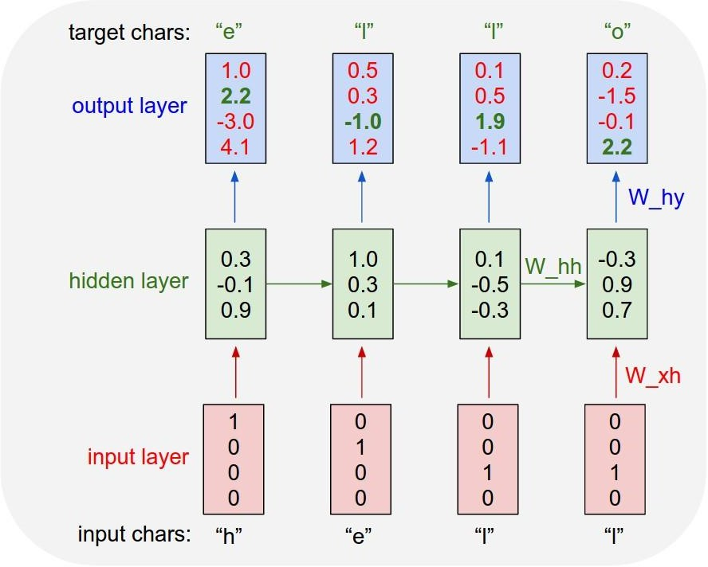
Example: Character-level Language Model
Vocabulary: [h,e,l,o]
Example training sequence: “hello”

Slide 57
Example: Character-level Language Model
Vocabulary: [h,e,l,o]
Example training sequence: “hello”
April 28, 2022

Slide 58
Example: Character-level Language Model
Vocabulary: [h,e,l,o]
Example training sequence: “hello”

Slide 59
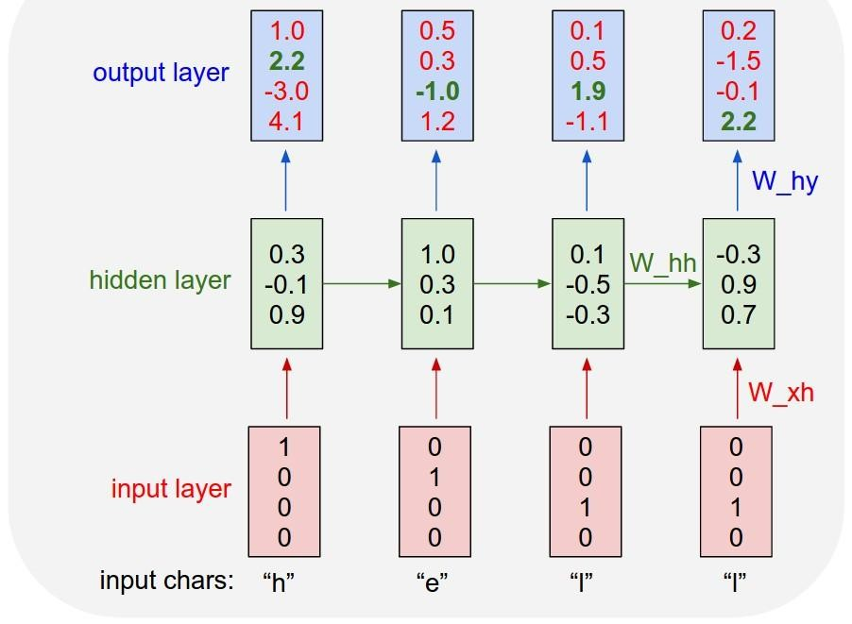
Example: Character-level Language Model Sampling
“e”
“l”
.25
.20
.05
.50
“l” “o”
.11 .11
.17 .02
.68 .08
.03 .79
Sample
.03
.84
.00
.13
Softmax
Vocabulary:
[h,e,l,o]
At test-time sample characters one at a time, feed back to model

Slide 60
Example: Character-level Language Model Sampling
“e”
“l”
.25
.20
.05
.50
“l” “o”
.11 .11
.17 .02
.68 .08
.03 .79
Sample
.03
.84
.00
.13
Softmax
Vocabulary:
[h,e,l,o]
At test-time sample characters one at a time, feed back to model

Slide 61
Example: Character-level Language Model Sampling
“e”
“l”
“l” “o”
.11 .11
.17 .02
.68 .08
.03 .79
Sample
.03
.84
.00
.13
.25
.20
.50
.05
Softmax
Vocabulary:
[h,e,l,o]
At test-time sample characters one at a time, feed back to model

Slide 62
Example: Character-level Language Model Sampling
“e” |  | “l” |  | “l” |  | “o”
.03 |  | .25 |  | .11 |  | .11
.84 |  | .20 |  | .17 |  | .02
.00 |  | .50 |  | .68 |  | .08
.13 |  | .05 |  | .03 |  | .79
Sample
Softmax
Vocabulary:
[h,e,l,o]
At test-time sample characters one at a time, feed back to model

Slide 63
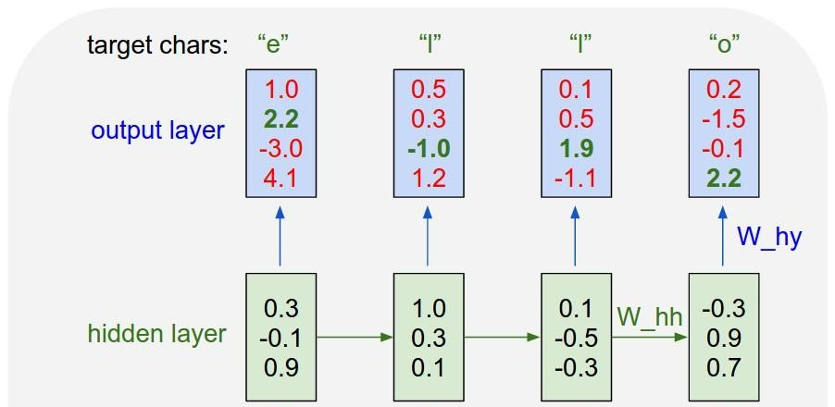
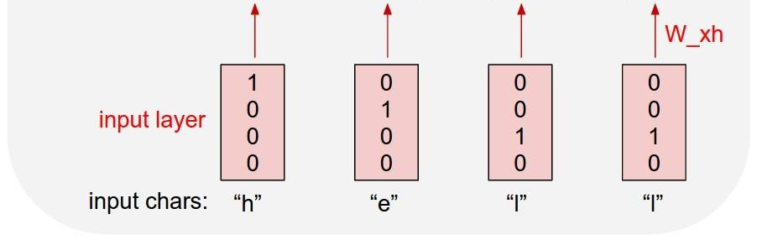
Example: Character-level Language Model Sampling
[w₁₁ w₁₂ w₁₃ w₁₄] [1] [w₁₁] [w₂₁ w₂₂ w₂₃ w₁₄] [0] = [w₂₁]
[w₃₁ w₃₂ w₃₃ w₁₄] [0] [w₃₁]
[0]
.03
.13
.00
.84
.25
.20
.05
.50
.11
.17
.68
.03
.11
.17
.68
.03
Embedding
layer
Matrix multiply with a one-hot vector just extracts a column from the weight matrix. We often put a separate embedding layer between input and hidden layers.

Slide 64
Exercise (CNN)
1. If we have data like this and kernel feature 2x2. Count the last pooling layer :
2. If we have input and filter kernel feature 2x2. Calculate until fully connected layer weight
0.2 | 0.4 | 0.6 | 0.8
0.3 | 0.7 | 0.5 | 0.1
0.6 | 0.4 | 0.8 | 0.9
0.9 | 0.2 | 0.3 | 0.7
1 | 0
-1 | 1
1 | 2 | 1 | 0
0 | 1 | 3 | 1
2 | 2 | 0 | 2
1 | 3 | 2 | 1
1 | 0
0 | 1

Slide 65
Exercise (MLP)
If there is weight :
Input : X1 = 0.5 X2 =0.3
Hidden to input w11 =0.4 w21 =0.3 w12 = 0.2 w22 =0.2
Bias to hidden b1=0.1 b2 =0.2
Hidden to output w01 =0.5 and w02 =0.7 bias b0=0.3
Using sigmoidal activation, calculate back propagation from MLP 1 hidden layer

Slide 66
Exercise MLP
Using XOR gate to get the activation weight (sigmoidal activation) if
W11 =0.15
W21 = 0.2
W12 = 0.25
W22 = 0.3
b1 and b2=0.35
W01 =0.4 W02 = 0.45 b0= 0.6
Calculate with MLP and back propagation neural network

Slide 67
Exercise (RNN)
If we want to predict next number based on input. If we have structure like this
- one neuron in hidden layer
- activation layer using sigmoid
- time step t =2
- input x1= 0.5 x2= 0.3
- hidden state input to hidden wx=0.3
- hidden state to hidden state wh =0.2
- hidden state to output wy =0.4
- bias hidden bh = 0.1
- bias output by = 0.05
Calculate RNN forward propagation

Slide 68
Reference
Suyanto. 2018. Machine Learning tingkat dasar dan lanjut. Penerbit Informatika
Hinton, G. E., Osindero, S. and Teh, Y. A fast learning algorithm for deep belief nets. Neural Computation 18 (2006), pp 1527-1554
Others online sources

